Slide 1
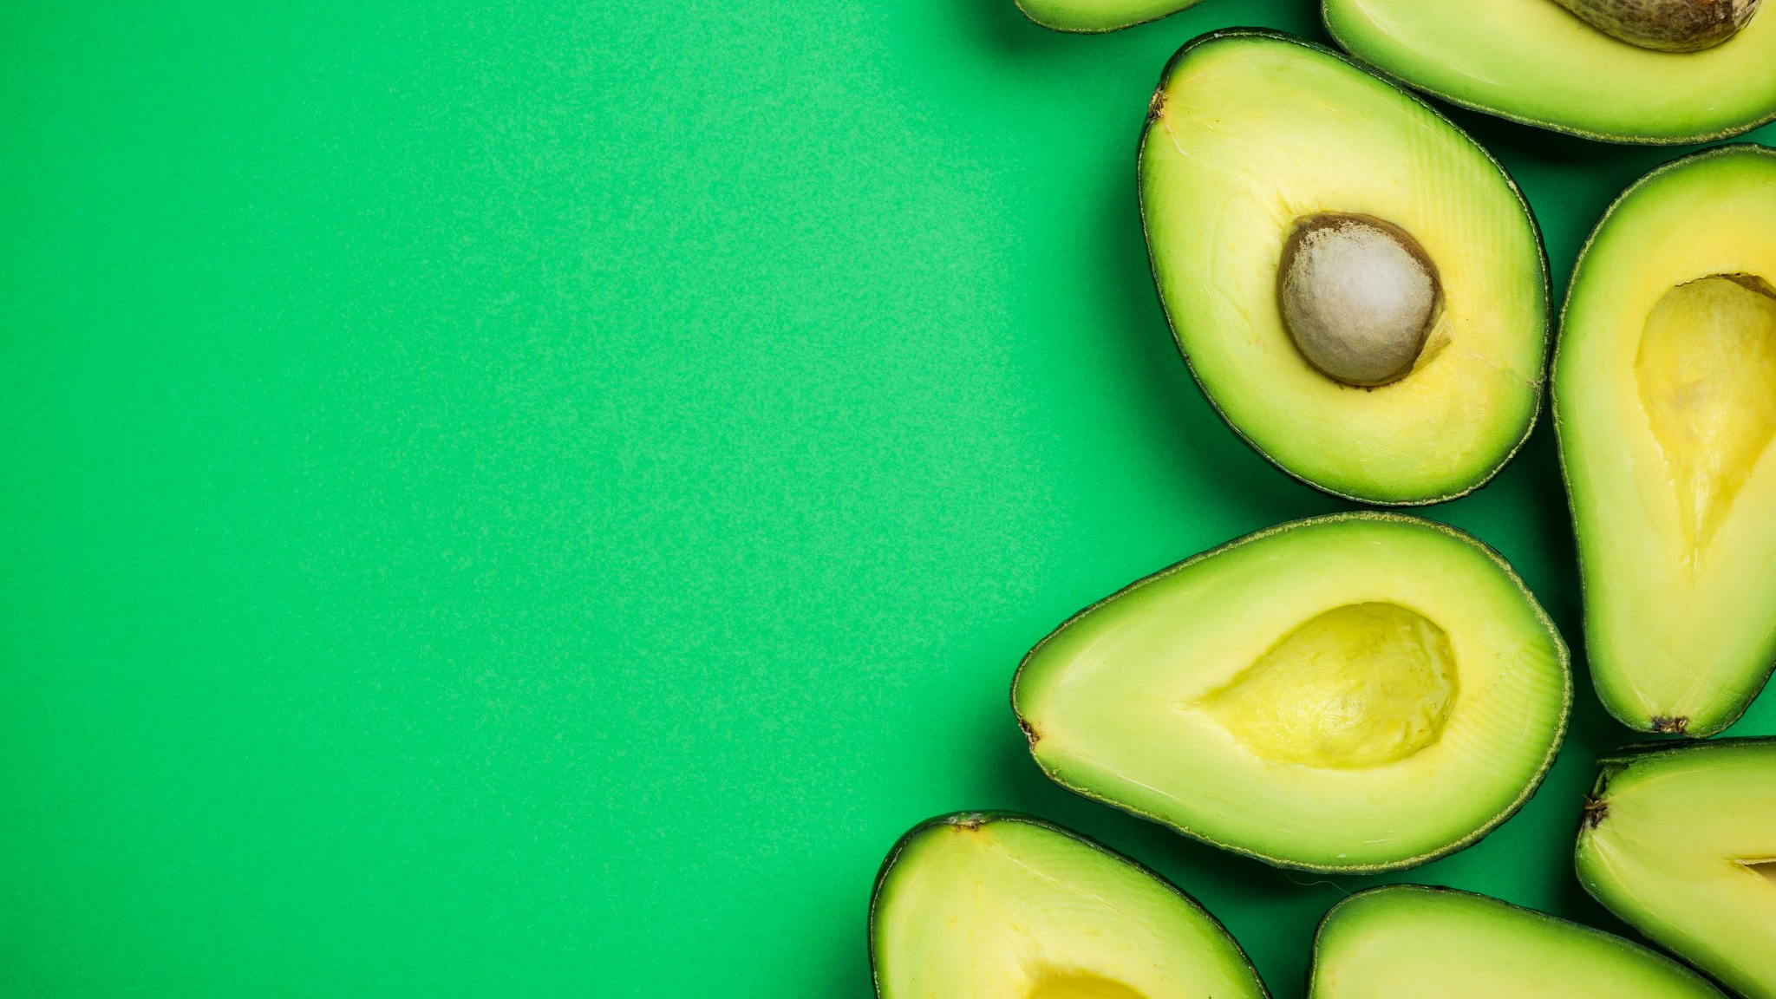
AVOCADABRA
R-Shiny
For Forecasting Avocado Demand

Slide 2
THE AVOCADO INDUSTRY
US Avocado Industry
Production in 2017: USD 392 million [1]
Demand has followed an upward trend since 1970 [2]
Imports in 2017: USD 2.6 billion

Slide 3
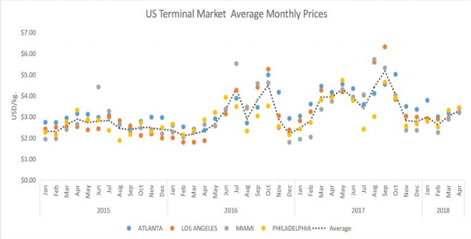
WHY DEMAND FORECASTING?
Requires Pricing Strategy
Mid-season price increase in May
Low prices in January and December
Y-o-Y increase in most markets
High prices in September and October
[4]
US Terminal Market Average Monthly Prices for Avocado [3]

Slide 4

WHY DEMAND FORECASTING?
Climate Change
Excessive Heat
Heavy Rains
Droughts
Fire
Factors affecting production
[5]

Slide 5
OBJECTIVE
Predicting the avocado quantity a retailer should order, based on user inputs
Date
Region
Type
Average Price
Predicted Order Quantity
User Inputs

Slide 6
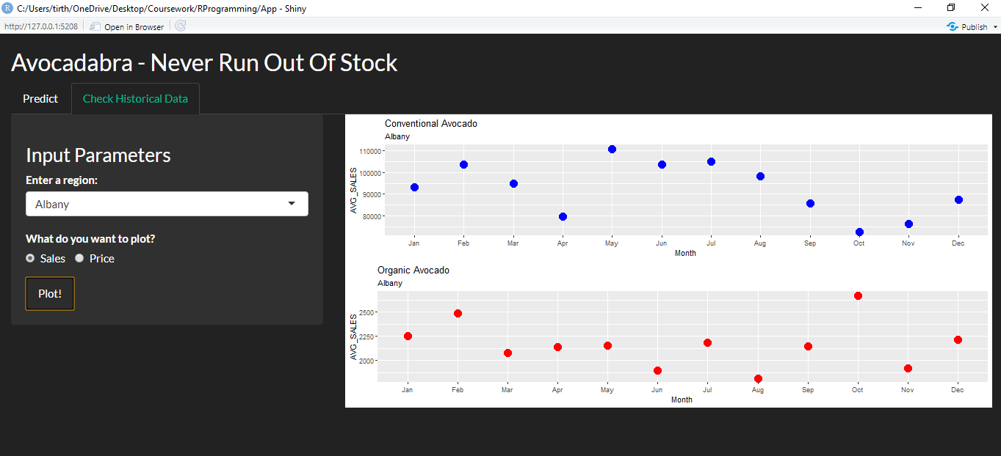
EDA: Volume Sold
Region;
Volume sold
Historical average sales for all the months

Slide 7
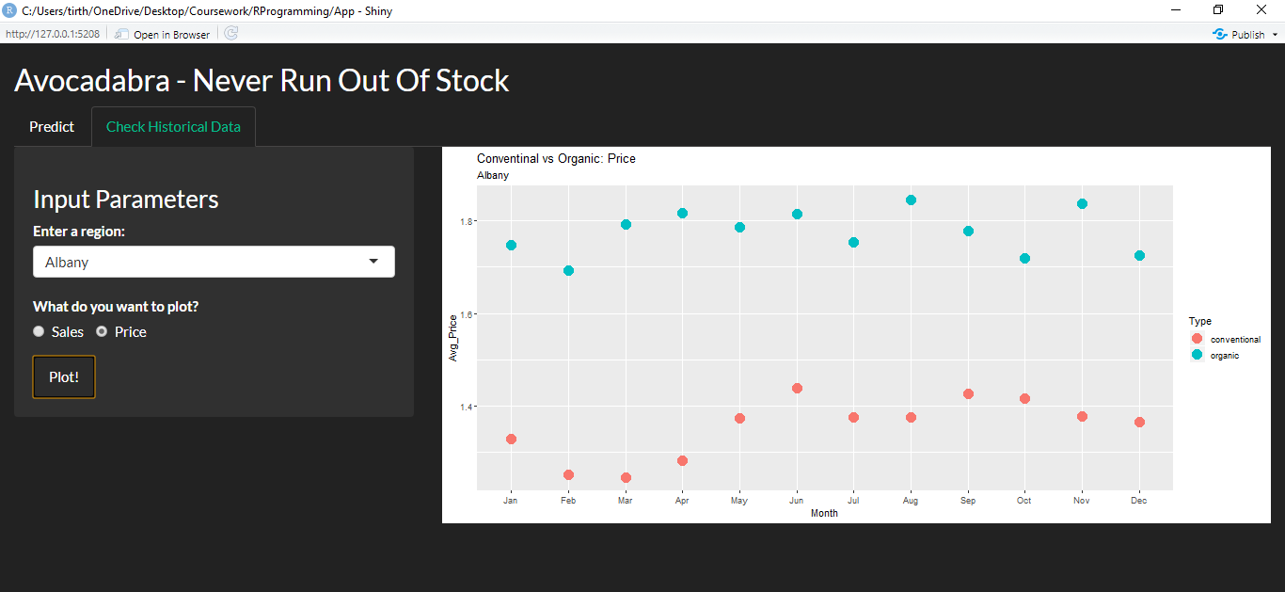
EDA: Price
Region;
Price
Historical prices of avocado for all the months

Slide 8
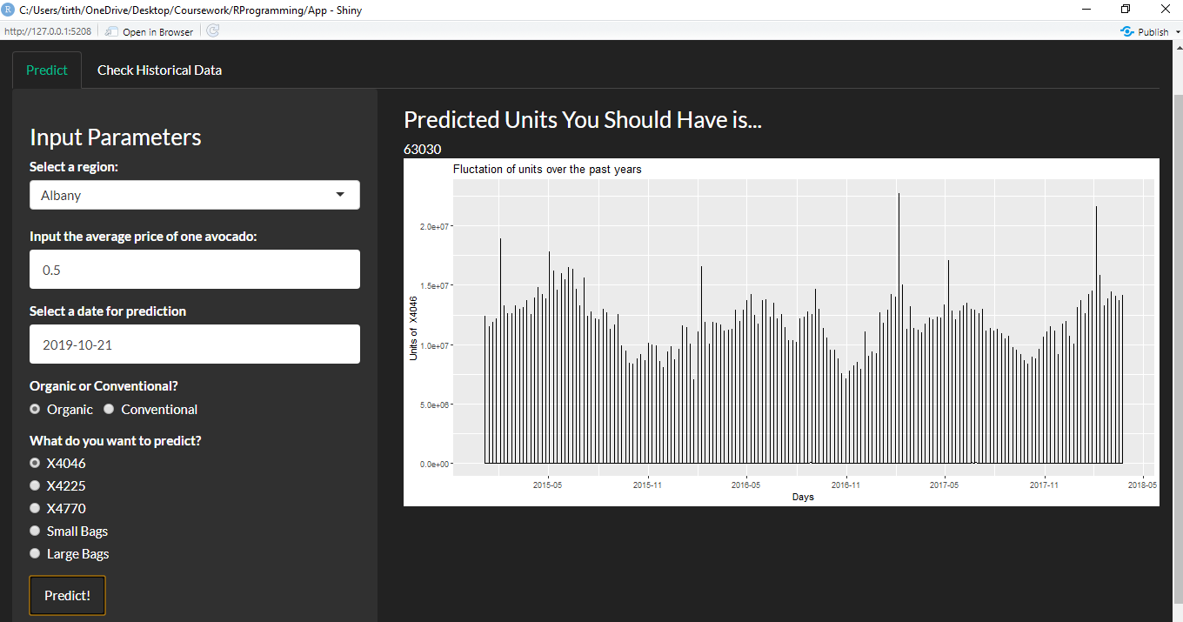
PREDICTIONS: Inventory count
Region; Average price; Date; Type; Grade
Units you should have in the inventory

Slide 9
CITATIONS
[1], [2] https://www.agmrc.org/commodities-products/fruits/avocados
[3] USDA data, interpreted and expanded by GT APP
[4] Blue Book Services, An inside look at avocado market fluctuations, 2019
[5] Showbiz Cheat Sheet, Here’s Why Avocados Are so Expensive Right Now, Jessie Quinn, 2018

